Slide 1
[ACL 22] Richer Countries and Richer Representations
Kaitlyn Zhou, Kawin Ethayarajh, Dan Jurafsky
Mahat Sabina
51195901001

Slide 2
1. Introduction
- Examine whether some countries are more richly represented in embedding space than others
- Countries whose names occur with low frequency in training corpora are more likely to be tokenized into subwords, are less semantically distinct in embedding space, and are less likely to be correctly predicted: e.g., Ghana (the correct answer and in- vocabulary) is not predicted for, “The country producing the most cocoa is [MASK].”.
- Although these performance discrepancies and representational harms are due to frequency, the frequency is highly correlated with a country’s GDP; thus perpetuating historic power and wealth inequalities.

Slide 3
Three criteria is suggested to characterize the quality of representations for particular entities or groups: consistency, distinctiveness, and recognizability.
For consistency, are all entities of a certain type (such as all country names) represented with the same number of tokens in the lexicon?
For distinctiveness, are entities of the same category seen as equally distinct in representational space?
For recognizability, are models capable of generating all entities of a certain type in response to ques- tions? And are the differences between entities confounded across lines of historical inequity (like wealth of countries)?

Slide 4
The main purpose from the paper is to..
Reveal multiple ways in which the BERT representation of high GDP countries is systematically richer than that of low GDP countries;
Study the effectiveness of potential mitigation efforts;
and propose the idea of representational guarantees as future work for the community.

Slide 5

2. Related Works
Language technologies have long been studied for potential intrinsic and extrinsic harms (Galliers and Jones, 1993). Known intrinsic harms include misrepresentation of gender (Bolukbasi et al., 2016), race (Abid et al., 2021), and ability (Hutchinson et al., 2020) — all types of representational harms (Barocas et al., 2017; Crawford, 2017; Blodgett et al., 2020). Other intrinstic harms include forms of erasure through under-representation of LGBTQ+ identity terms (Strengers et al., 2020; Oliva et al., 2021) and racial groups (Gehman et al., 2020). Extrinsic harms are often found in downstream tasks and include disparities in quality of service among user groups (Zhang et al., 2020) such as African-American users (Blodgett and O’Connor, 2017; Koenecke et al., 2020). However, low statistical power has also made it difficult to make conclusive claims about the presence or absence of bias (Ethayarajh, 2020).
Many of these representational harms have been linked to word frequency in static embeddings (Bolukbasi et al., 2016; Caliskan et al., 2017; Zhao et al., 2018; Bordia and Bowman, 2019; Ethayarajh et al., 2019b; van Loon et al., 2022). Low frequency words also differ geometrically from other words, with smaller inner products (Mimno and Thompson, 2017) and lower variance (Ethayarajh et al., 2019a). Recent work has also shown how frequency impacts contextual embeddings such as the underestimation of cosine similarity among high-frequency words (Zhou et al., 2022) and the discrepancies in representations of personal names (Shwartz et al., 2020; Wolfe and Caliskan, 2021). This paper extends these lines of work via the examination of representational harms for country names.

Slide 6

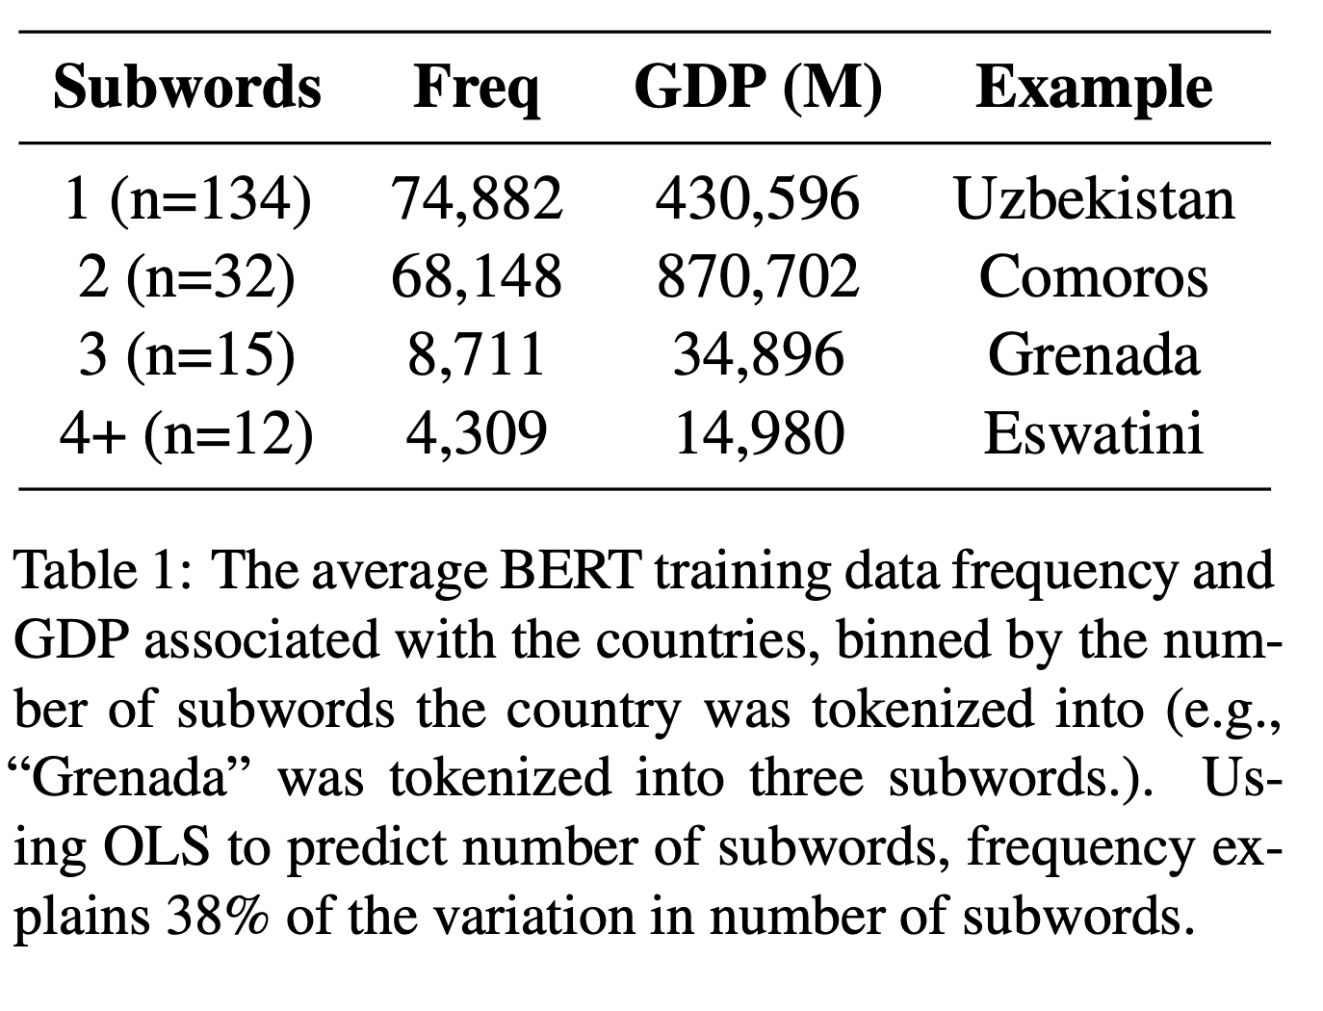
3. Rich Countries have their own Tokens
- Of the 159 single-word countries names from the United Nations members list, 134 of them are in-vocabulary, — the remaining 25 are out- of-vocabulary (OOV). In WordPiece tokenization, OOV words are tokenized into in-vocabulary subwords (e.g. “Andorra” becomes “And” and “##orra”).

Slide 7
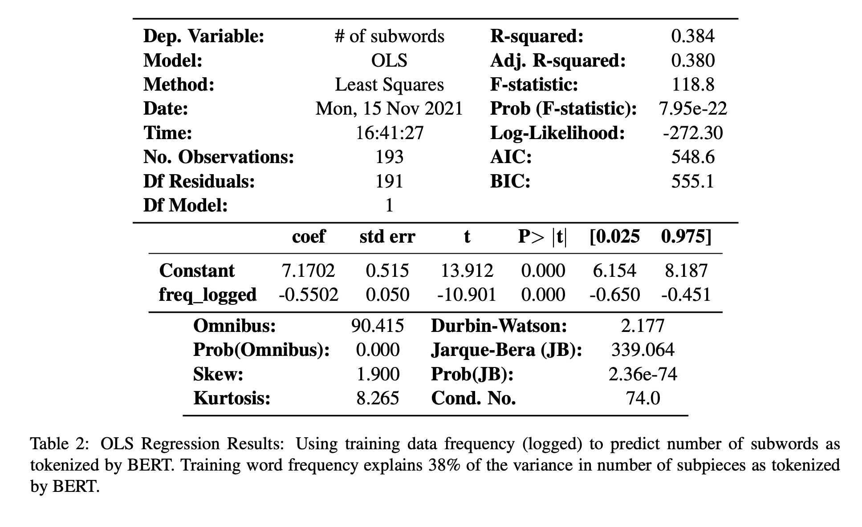
Ordinary least squares regression is used to predict the number of subword tokens in each country name, using training data frequency of each country name as the feature (BERT training data estimated from the March 1st, 2020 Wikimedia Download and BookCorpus) (Zhu et al., 2015; Hartmann and dos Santos, 2018).⁶.
Training data frequency explains 38% of the variance in number of subwords (p < 0.01), despite the confounder of multi-word countries being considered OOV (Table 2). Given that the training data frequency of a country’s name correlates strongly with its GDP ( Pearson’s r = 0.82), the countries that have the highest number of subwords are also the ones with the lowest GDP.

Slide 8
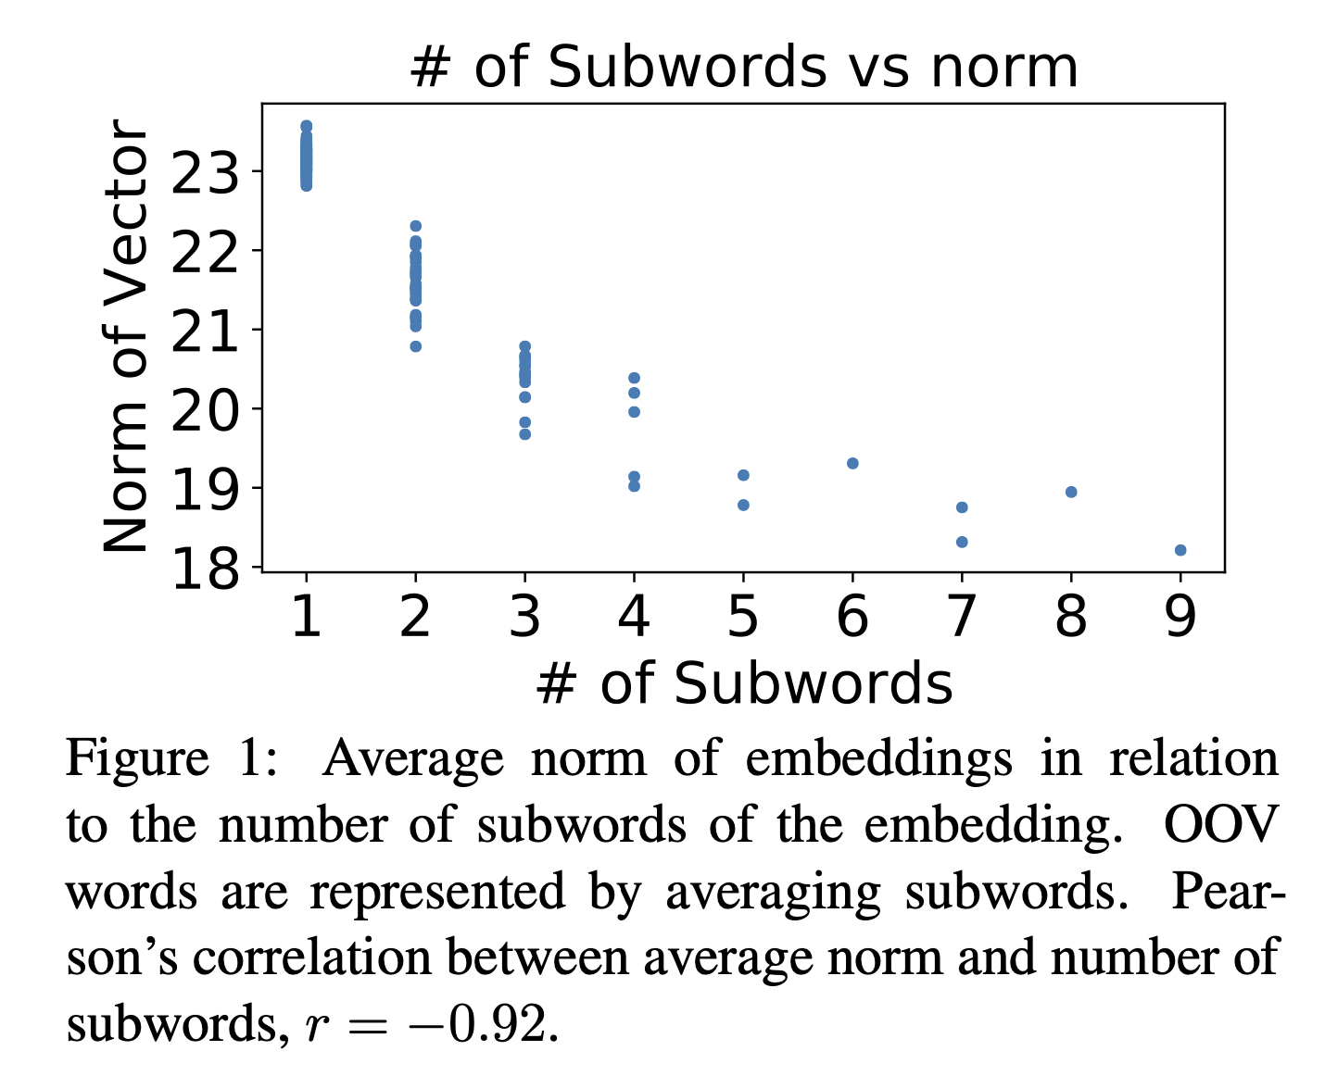
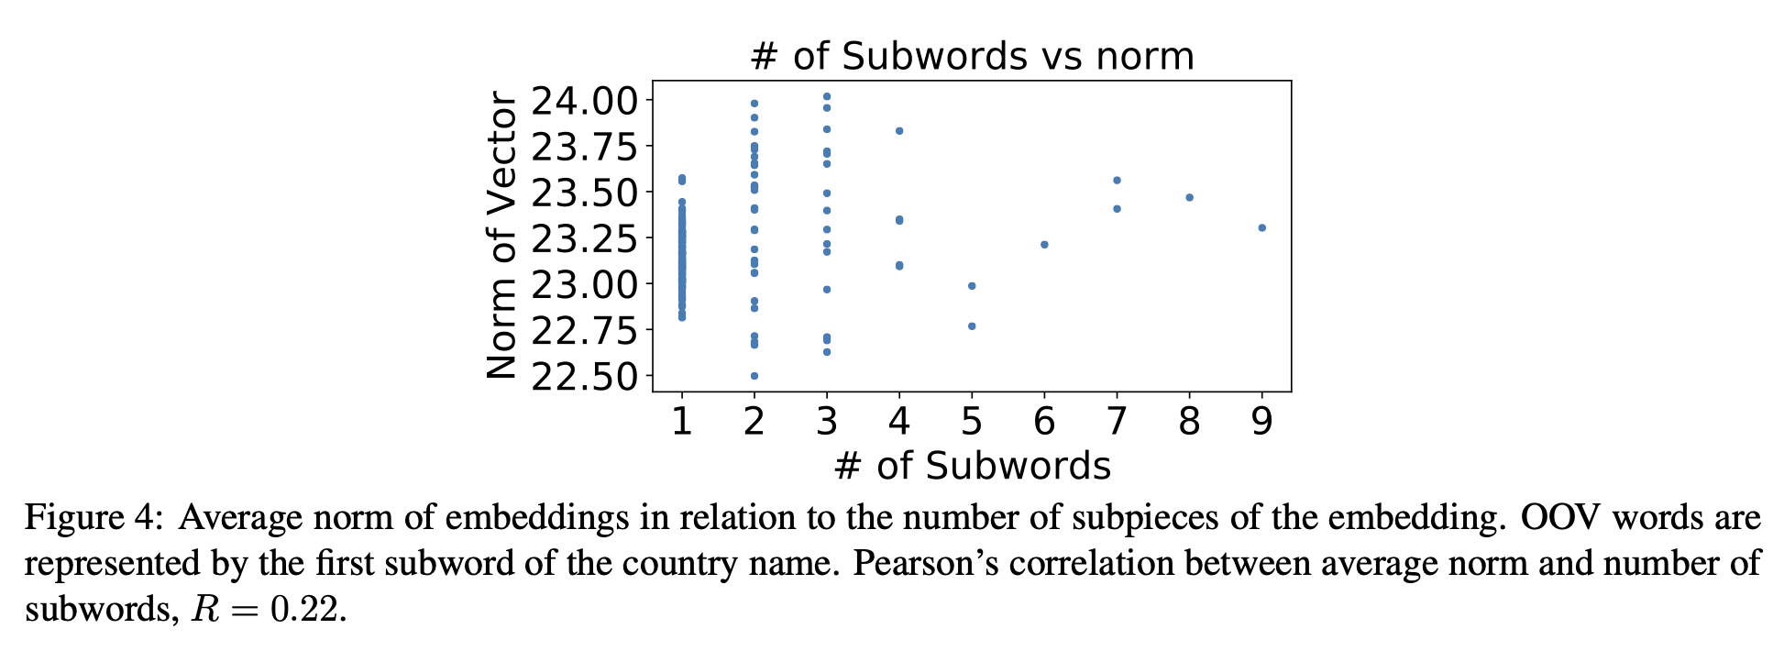
3.1 Geometric Impact of being OOV
The first subword of OOV words are more likely to be stop words, which are known to have larger norms (Ethayarajh, 2019). The difference in geometry between OOV and in-vocabulary words exists in both representation methods. This could result in impacts on tasks using embedding based retrieval (e.g., nearest-neighbor LM) as low-frequency names will have additionally distinguishing geometric characteristics as a result of tokenization.
Inconsistency in tokenizing country names leads to inconsistency in geometric representation. A potential mitigation might be to have all country names be in-vocabulary with a dedicated token. This might not address all impacts of training data frequency imbalances, but would at least prevent additional geometric differences due to tokenization.

Slide 9

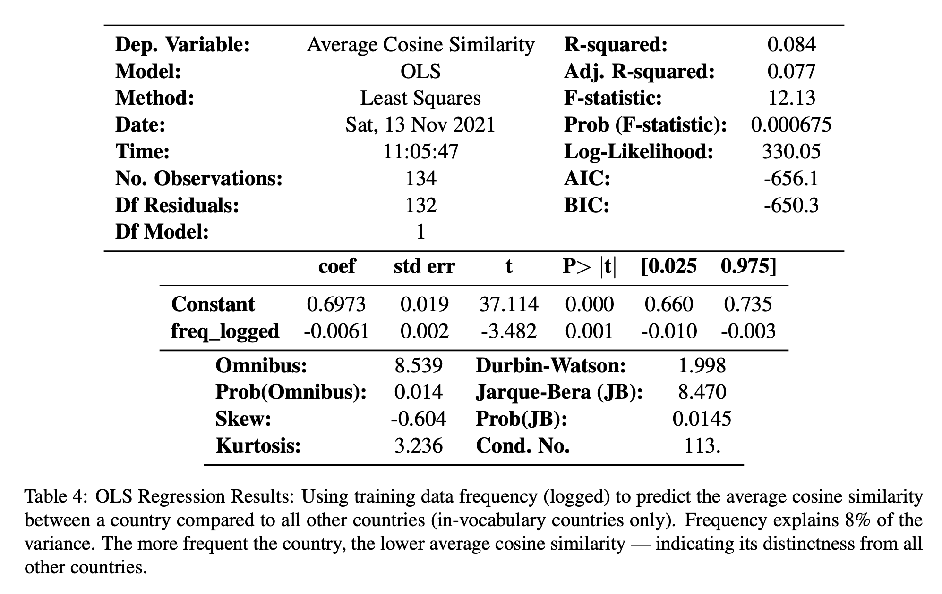
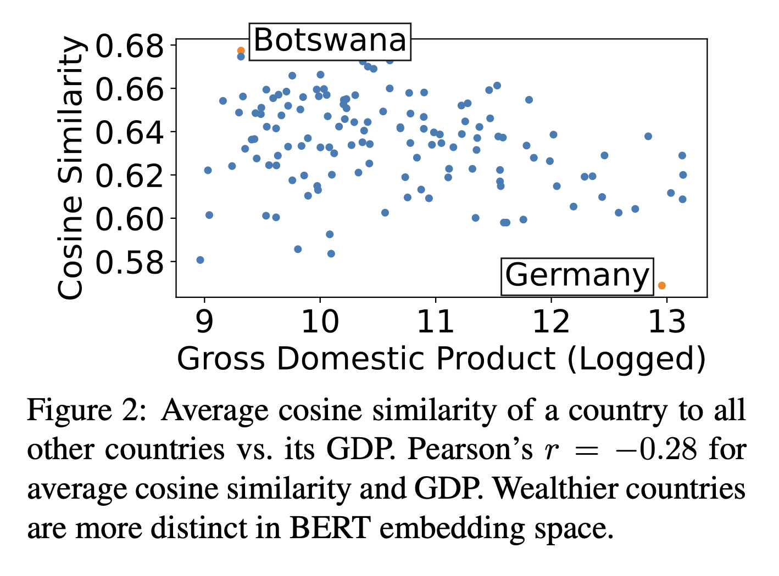
4. Richer Countries are Most distinct in Embedding Space
- The semantic similarities measured between 134 in-vocabulary countries by creating word embeddings for each name.

Slide 10
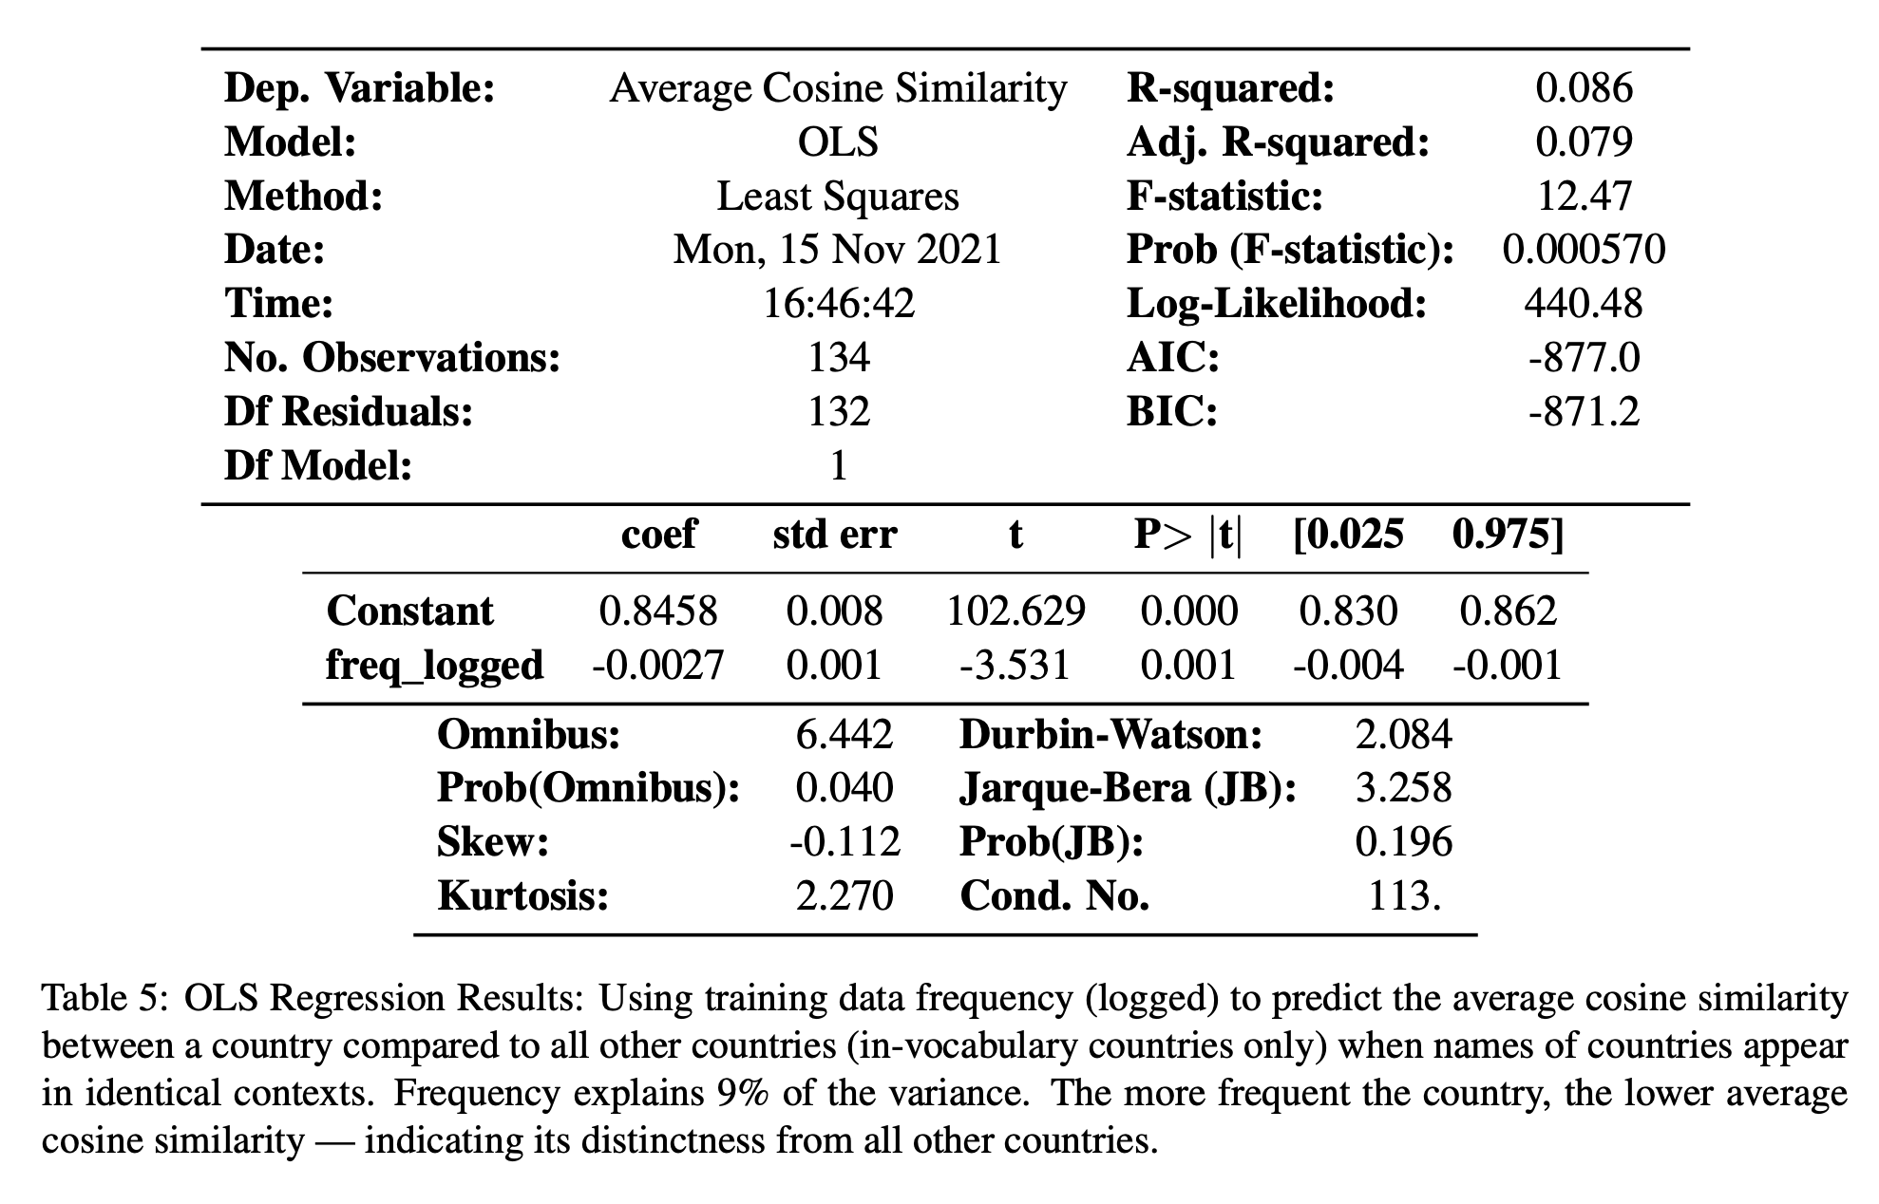
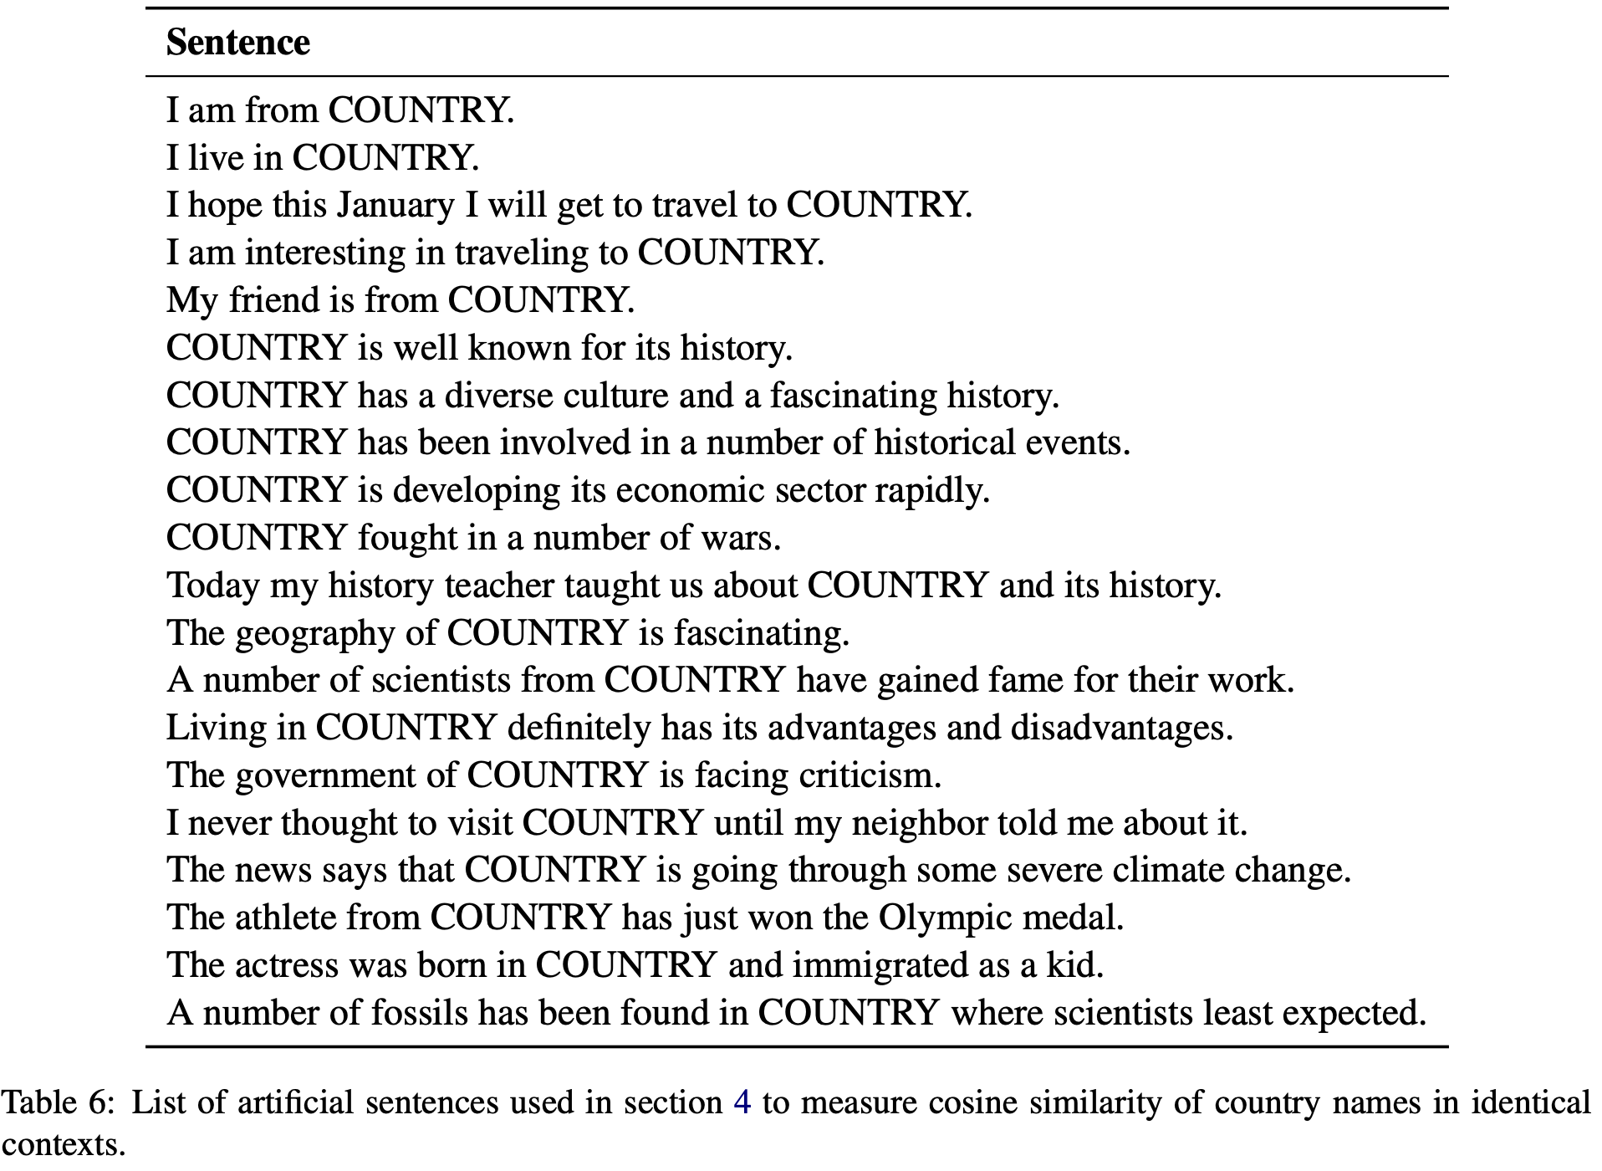

Slide 11
4.1 Tokenization and Semantic Similarity
Tokenization results in geometric differences between OOV and in-vocabularly words.
OOV country names have higher in-group similarity averages when averaging subpieces (0.668 vs 0.628; mean δ = 0.040, permutation test p < 0.01). Given that OOV words have smaller norms and are closer to the centroid, this signals a concentration of low- frequency words.
However, when using the first subpiece to represent OOV words, OOV country names have lower in-group similarity averages than in-group similarity among in-vocabulary words (0.589 vs 0.625; mean δ = 0.037, permutation test p < 0.001) — it shows that these embeddings conversely have larger norms and could be more widely dispersed.
The key takeaway here is that both methods show semantic differences between in-vocabulary and OOV words; again there are potential impacts in embedding-based downstream tasks.

Slide 12
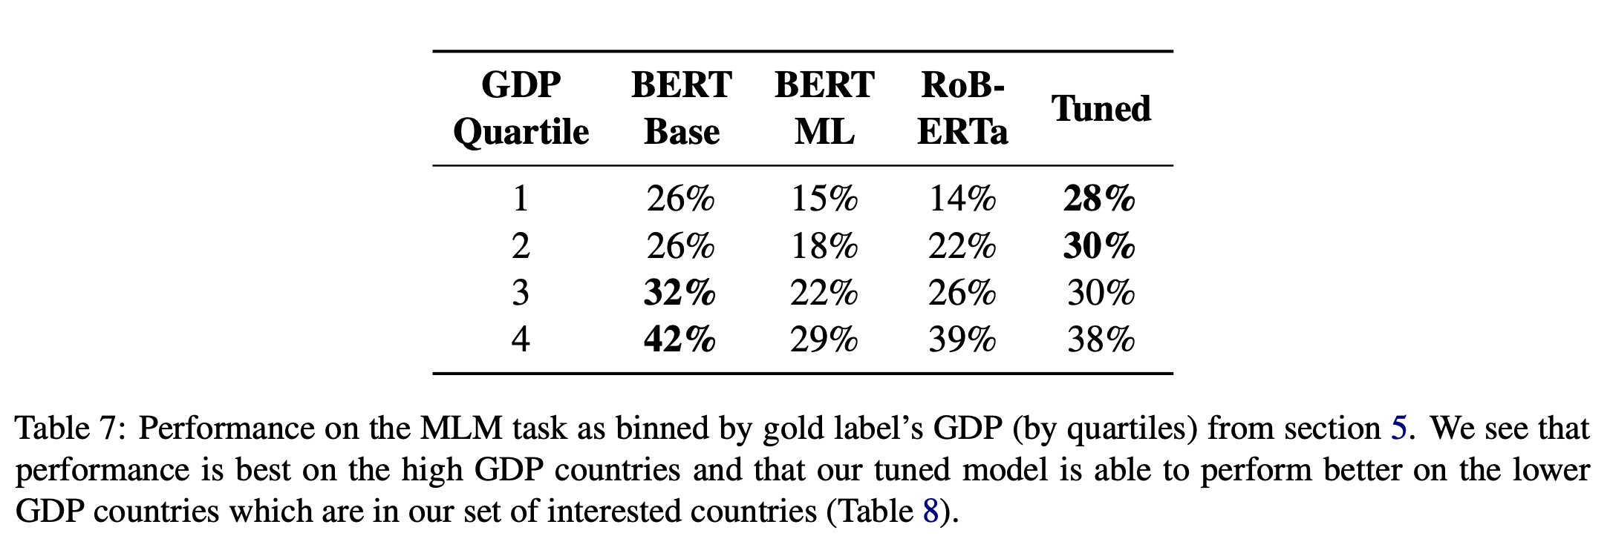
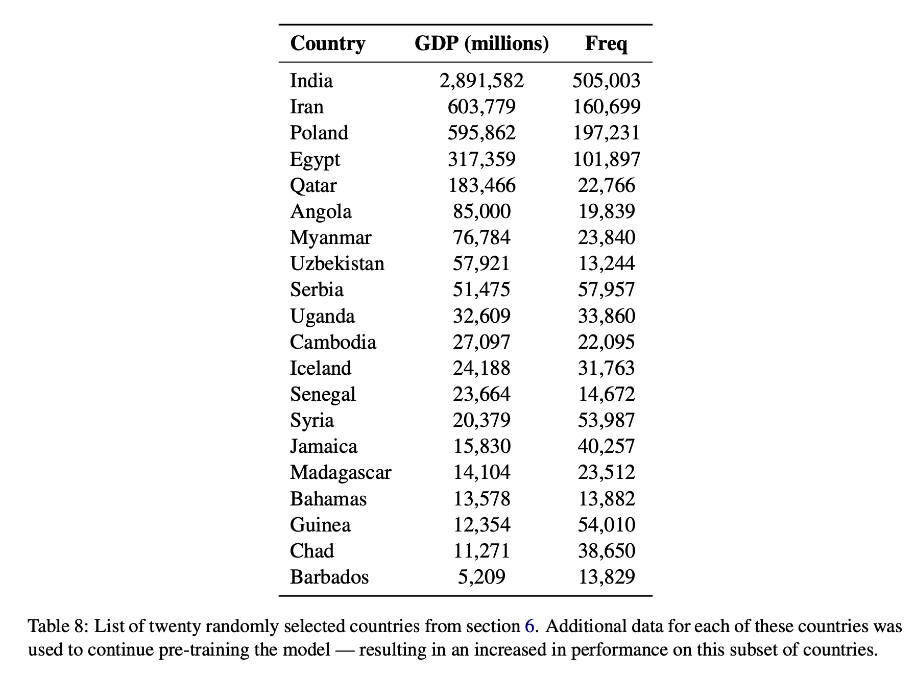
5. Rich Countries are more frequently predicted
Masked language modeling task is used as a proxy for many downstream tasks that need to be able to predict the name of a country to measure whether countries are all minimally predicted or representational harms such as erasure are seen
Randomly sample sentences from Wikipedia that contain the name of a country, replace the name with a BERT mask token ([MASK]), and use the masked-out country name as the gold label. 100 examples of each of the 134 in-vocabulary country names is used.
The model will only predict in- vocabulary words, which again illustrates the impact of inconsistent tokenization: the very task BERT was trained on is unable to handle OOV country names without modification.

Slide 13
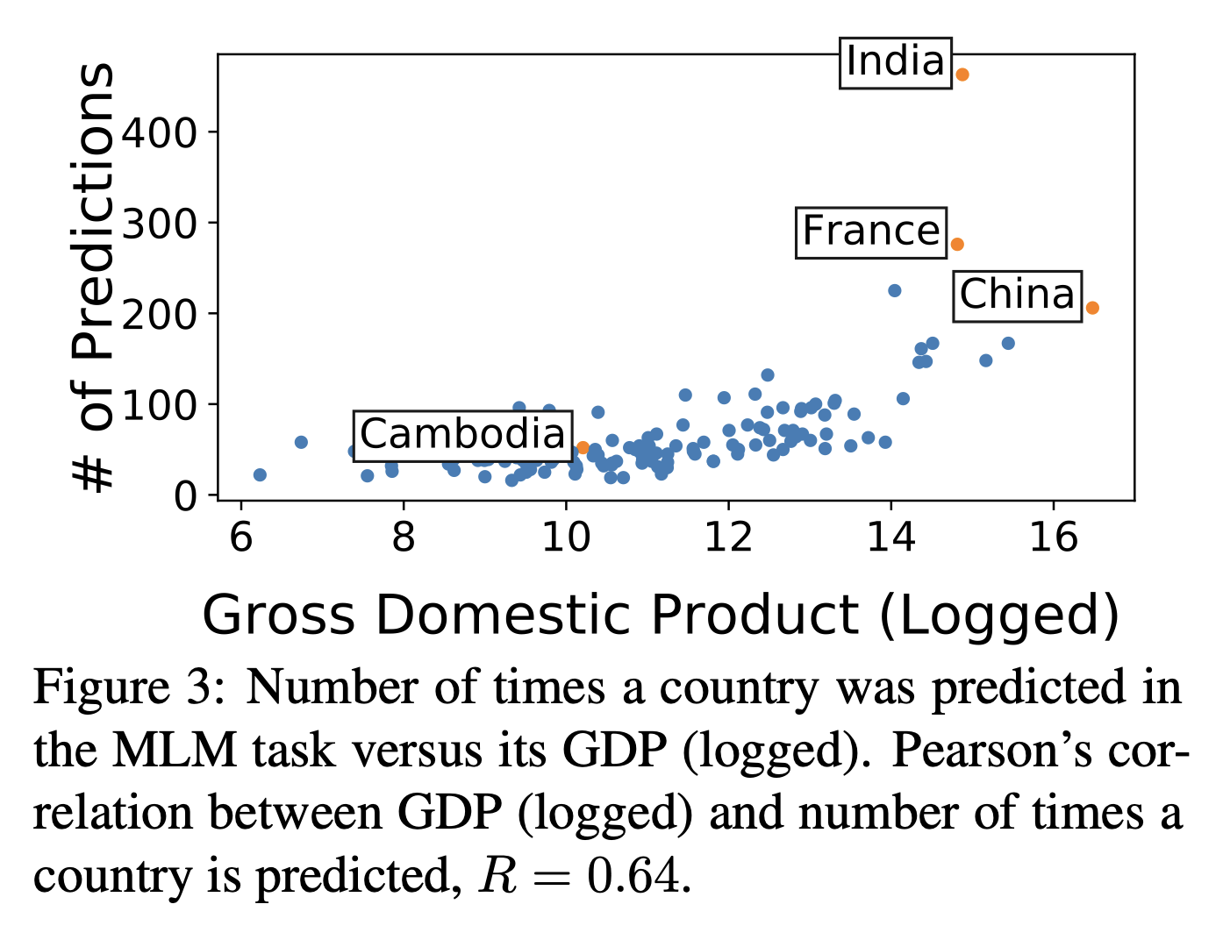
Of all the country names predicted, the 10 least predicted countries make up 2% of total guesses compared to 25% for the top 10 most predicted countries.
BERT fails this task in drastic ways; predicting China, India, Brazil for, “The poorest country in the world is [MASK].” (Burundi and Somalia ranked as the poorest by GDP/capita). This reduced recognition of poor countries is a representational harm.

Slide 14
6.The limitations of Mitigation Efforts
Could these frequency-based effects be mitigated with additional training data? The performance of Multilingual BERT (BERT-ML) is measured which includes Wikipedia articles from 104 other languages then is continued to find accuracy disparities between low and high GDP countries (15% vs 29%). Additional training data fails to mitigate these harms, most likely because the additional data continues to amplify existing imbalances (i.e., German, French, and Polish are the next three biggest languages of Wikipedia articles). Data augmentation as a mitigation technique is challenging as datasets could easily maintain existing or introduce new frequency imbalances. We also tested RoBERTa (trained on over 160GB more data) on this task with similar results (table 7).
Could fine-tuning or continuing pre-training mitigate these harms? 20 random countries (Appendix table 8) is selected; for each, 1000 random sentences from Wikipedia that mentions the country’s name is selected. After four epochs of training, an evaluation dataset (100 examples/country) is tested where 13% increase in performance is seen on the selected countries and a 3% decrease for other countries (table 9 and figure 5). The subset of interested countries originally made up 17% of all guesses, but this rate more than doubles in the tuned model. This pre-training mitigation method shows promise but has trade-offs in performance, requires practitioners to be aware of inequalities, and have access to enough training samples to continue pre-training effectively.

Slide 15
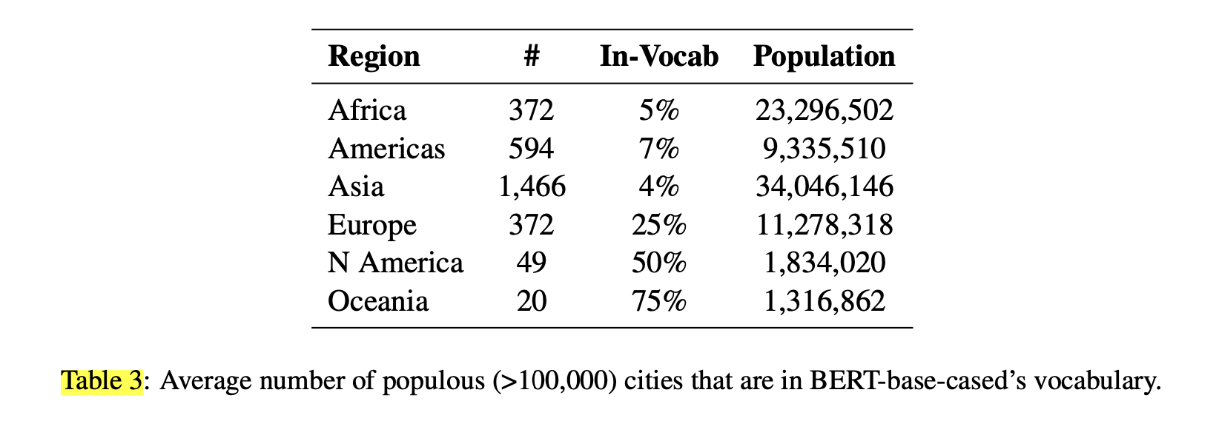
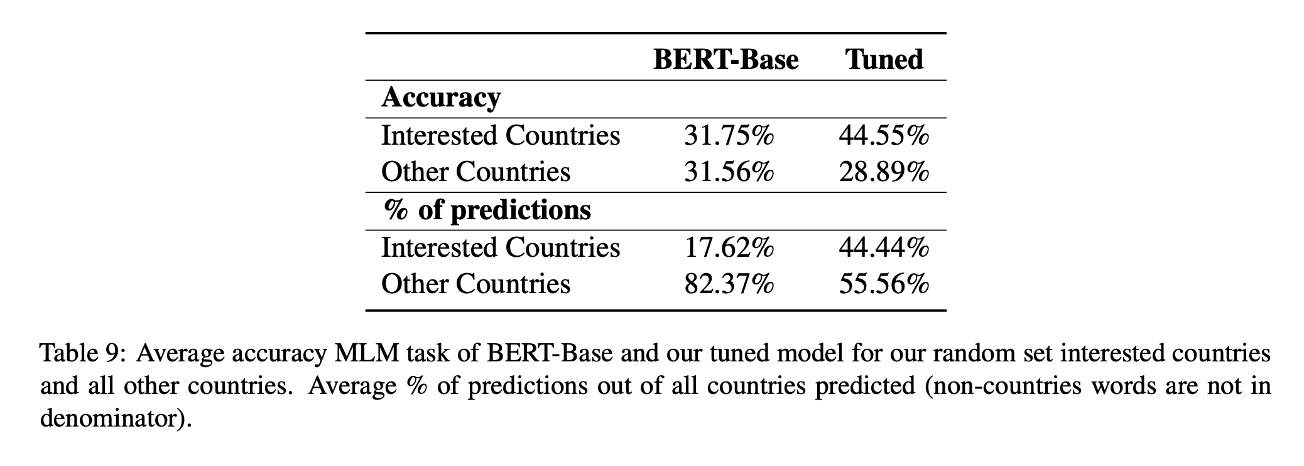
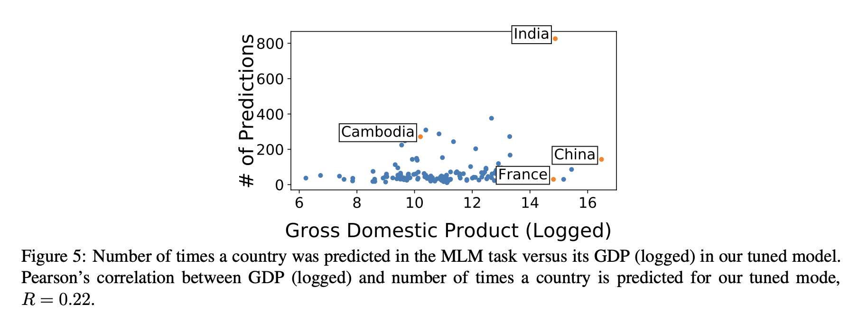

Slide 16
7. Conclusion
- The significant disparities in the quality of representation of country names is found and how these differences result in representational harms that perpetuate existing wealth and power inequalities is shown in the paper.
- The release of training word frequencies is recommended to increase transparency and isolate current representational harms (Gebru et al., 2021; Mitchell et al., 2019; Bender and Friedman, 2018; Ethayarajh and Jurafsky, 2020).
- Consider designing representational guarantees for significant entities is recommended to mitigate the downstream harms. This paper illustrates the potential harms that arise when entities such as country names do not have representational guarantees.

Slide 17
Thank you for your time !

